Slide 1
Engineering in the News
Monday 2 November 2026
Born to Engineer · a 10-minute tutor time pack
Three stories this week: flood defences, a pocket eye scanner and an electric railway
Notes:
Welcome. This pack takes about 10 minutes: one minute per story slide, five minutes on the debate and two on the challenge. All three stories are on borntoengineer.com/stem-news.

Slide 2
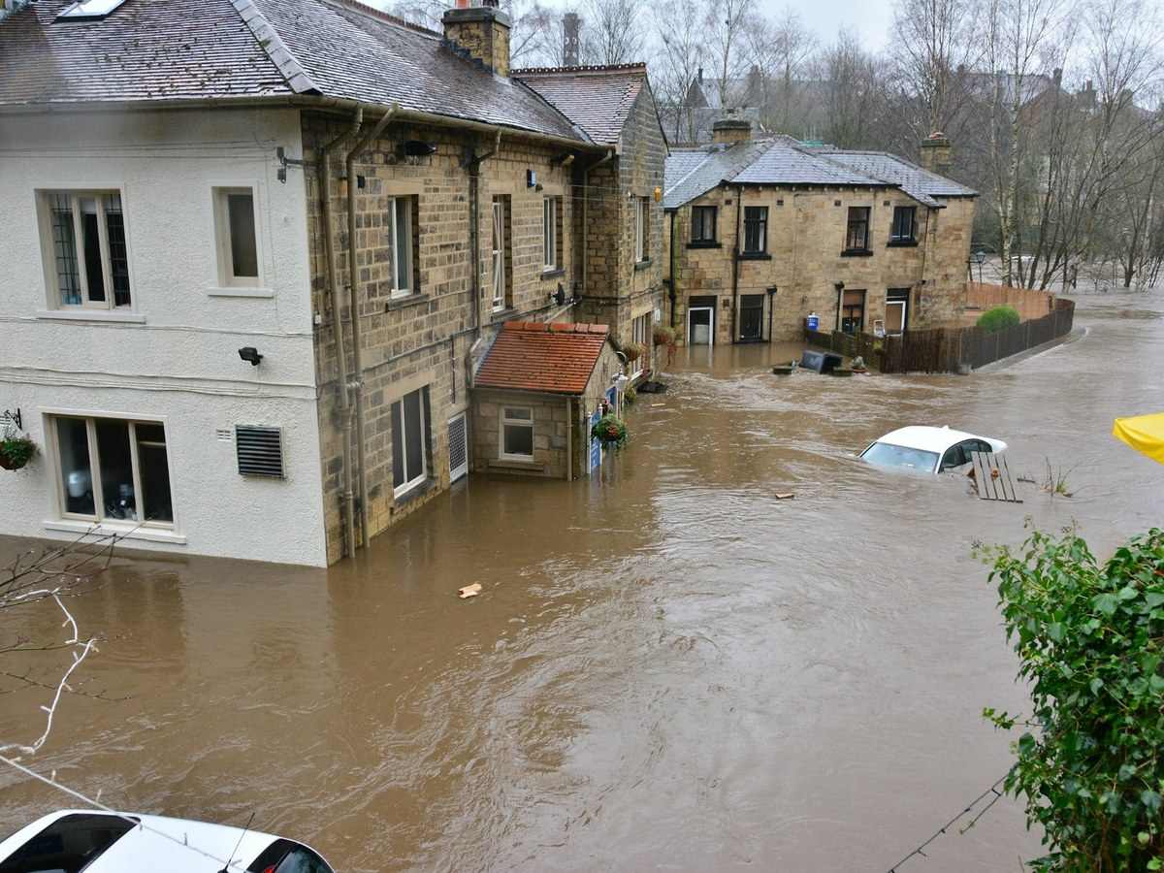
Duct tape beats sandbags in flood tests
CONSTRUCTION AND INFRASTRUCTURE
University of Hull engineers flooded six types of front door to a depth of 60 cm.
Duct tape on the outside cut leakage by 97 to 98%.
A wall of 54 sandbags managed only about 70%.
The science behind it
Pressure in liquids rises with depth: p = ρgh (GCSE Physics, forces)
Jobs behind the story
Hydraulic engineer · Laboratory technician
Image: Chris Gallagher on Unsplash
Notes:
Story: University of Hull tests for Flood Re at PFRlab. Six common door types were tested with water raised in 5 cm steps to 60 cm. Duct tape on the outside of the door cut leakage by 97 to 98% against an unprotected door. 54 sandbags with plastic sheeting cut it by around 70%. Flood putty tape did best, up to 99%. Tape on the outside works better because the water pushes it against the door; on the inside the same pressure peels it away. The researchers stress tape is a cheap first step, not a replacement for proper flood doors.
Jobs: civil and hydraulic engineers work out how floodwater moves and the forces it puts on buildings; technicians build and run the test rigs.
Story: https://www.borntoengineer.com/duct-tape-flood-protection

Slide 3
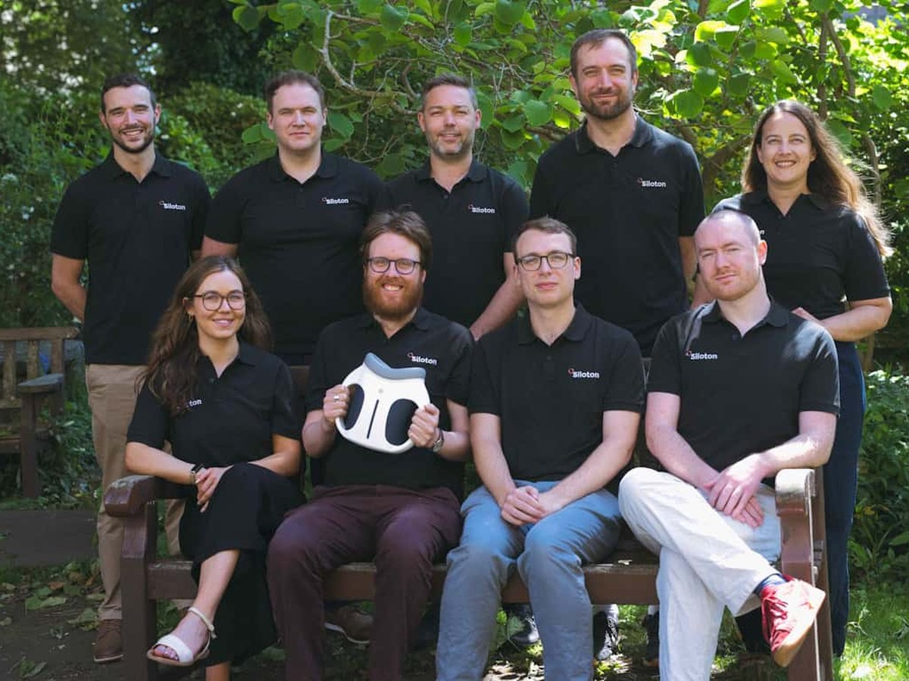
A hospital eye scanner shrunk onto a chip
HEALTH
Bristol start-up Siloton has won £8.4 million to build a handheld eye scanner.
Its photonic chip does the job of a desktop OCT machine.
Clinical trials will run at Sunderland Specialist Eye Hospital.
The science behind it
Light reflects off each layer of the retina and the waves interfere (A-level Physics, waves)
Jobs behind the story
Photonics engineer · Biomedical engineer
Image: Siloton
Notes:
Story: Siloton, a Bristol start-up, has an £8.4 million Innovate UK contract to develop GiraffeOCT, a handheld retinal scanner. Optical coherence tomography (OCT) normally needs a desktop machine; Siloton puts the optics on a photonic chip called BlueJay, where light travels along waveguides etched into silicon. Ophthalmology is the busiest NHS outpatient specialty, with around nine million appointments a year. Trials of the in-clinic version will run at Sunderland Specialist Eye Hospital, and a home version is planned.
Science: OCT is like ultrasound with light. An interferometer splits the beam; one half goes into the eye, one to a reference mirror, and the interference pattern when they recombine gives depth.
Jobs: photonics engineers design the chip; biomedical engineers turn it into a safe medical device.
Story: https://www.borntoengineer.com/bristol-start-up-shrinks-hospital-eye-scanner-onto-chip-smaller-than-pound-coin

Slide 4
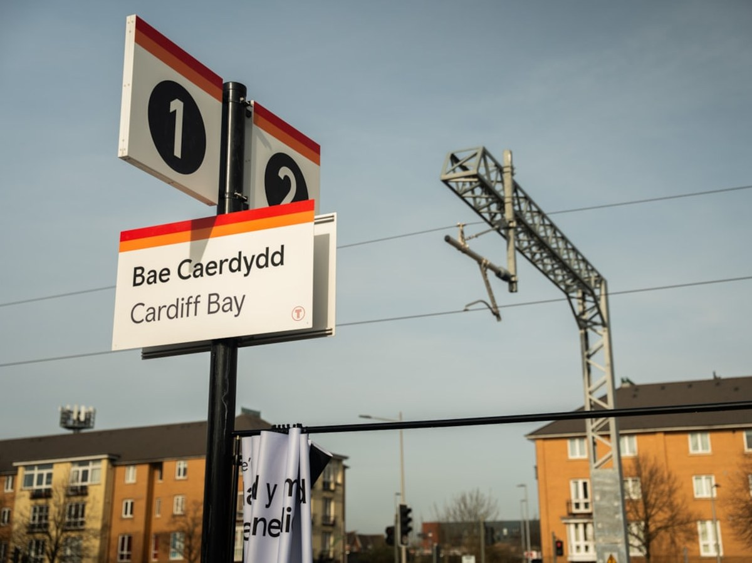
Wales electrifies its Valleys railway
TRANSPORT
Transport for Wales has finished electrifying 170 km of track in the South Wales Valleys.
Under low Victorian bridges, trains switch to batteries.
The project won the top prize at the 2026 construction and infrastructure awards.
The science behind it
Batteries store energy, then recharge from the wires (GCSE Physics, electricity)
Jobs behind the story
Electrification engineer · Track engineer
Image: Transport for Wales
Notes:
Story: Transport for Wales completed the £1 billion Core Valley Lines electrification, 170 km of track. Engineers installed 281.5 miles of overhead wires and lowered 14 track beds. Instead of rebuilding every low Victorian bridge (overhead wires need about 4.7 m of clearance), the Smart Electrification System leaves gaps under some bridges and trains run on batteries there, recharging when they are back under the wires. It won the Sir John Armitt Prize at the British Construction and Infrastructure Awards 2026.
Jobs: electrification and power engineers, track and civil engineers, signalling engineers. Apprenticeships with Network Rail, Transport for Wales and contractors are a common route in.
Story: https://www.borntoengineer.com/wales-completes-1-billion-railway-electrification-wins-uks-top-infrastructure-award

Slide 5
Five-minute debate
Pick a statement. Half the group argues for it, half against.
1
Flood defences
2
Eye scanner
3
Railway
Every home in a flood risk area should keep a roll of duct tape by the front door.
Health checks done at home will one day replace most hospital appointments.
Batteries are a smarter fix than rebuilding every low Victorian bridge.
Notes:
Give the group one statement, or let each table pick one. Two minutes to prepare, three to argue.
1. Duct tape. For: it cut leakage by 97 to 98% in the Hull tests, a roll costs £10 or less and taping a door takes 10 to 20 minutes. Against: the researchers say it is no substitute for proper flood doors, and water still gets in through floors, walls, airbricks and drains.
2. Home health checks. For: ophthalmology is the busiest NHS outpatient specialty and handheld scanners could catch eye disease earlier, closer to home. Against: who checks the images, and what happens when a scan is done badly or a patient needs treatment straight away.
3. Batteries on railways. For: Transport for Wales avoided rebuilding dozens of bridges, with fewer road closures and less concrete and steel. Against: batteries add weight and cost to every train, and some routes may be too long for battery gaps.
Stories: https://www.borntoengineer.com/duct-tape-flood-protection, https://www.borntoengineer.com/bristol-start-up-shrinks-hospital-eye-scanner-onto-chip-smaller-than-pound-coin, https://www.borntoengineer.com/wales-completes-1-billion-railway-electrification-wins-uks-top-infrastructure-award

Slide 6
Two-minute challenge
Estimate how hard a 60 cm flood pushes on a front door 0.9 m wide.
1
Pressure at the bottom
p = 1,000 × 9.81 × 0.6 ≈ 5,900 Pa
Answer
About 1,600 N
The weight of a 162 kg mass, pressing on the bottom of one door.
2
Average over the wet door
Half: 2,943 Pa on 0.9 × 0.6 = 0.54 m²
3
Force = pressure × area
2,943 × 0.54 ≈ 1,600 N
More stories: borntoengineer.com/stem-news
Supports Gatsby Benchmark 4: linking curriculum learning to careers.
Notes:
Challenge: estimate the force of a 60 cm flood on a front door 0.9 m wide.
1. Pressure at the bottom: p = ρgh = 1,000 × 9.81 × 0.6 = 5,886 Pa, about 5.9 kPa.
2. Pressure is zero at the surface, so the average over the wet part of the door is half: about 2,943 Pa. The wet area is 0.9 × 0.6 = 0.54 m².
3. Force = average pressure × area = 2,943 × 0.54 ≈ 1,590 N, about 1,600 N. That is the weight of a 162 kg mass.
Extension: halve the depth to 30 cm. Both the average pressure and the area halve, so the force drops to a quarter (about 400 N). Force rises with the square of the depth.
Worked example from: https://www.borntoengineer.com/duct-tape-flood-protection

